Slide 1
OBJECT-ORIENTED METHODOLOGIES
CH-4

Slide 2
Chapter’s Objective
You should be able to define and understand:
O-O Methodolgies
The Rumbaugh et al. OMT
The Booch methodology
Jacobson’s Methodologies
Patterns (Very Important)
Frameworks
Unified Approach (UA)

Slide 3
Object- Oriented Methodology
Object- Oriented Methodology is a set of
Methods
Models
Rules
For developing the system.
Modeling provides a means for conceptualizing and communicating ideas in a precise, easy to understand and unambiguous form.

Slide 4
4.1 INTRODUCTION: TOWARDS UNIFICATION – TOO MANY METHODOLOGIES
BEST PRACTICES ARE UNIFIED- DUE TO TOO MANY METHODOLOGIES:
- Booch-1986 object-oriented design concept, Booch method
Sally Shlaer & Steve Mellor (1989 – 91) OO Systems Analysis + Object Lifecycles
Peter Coad & Ed Yourdon (1991) (OOA & OOD) prototype-oriented approach
Wirfs-Brock-1990 Class-Responsibility-Collaboration (CRC) Methodology
Booch/Rational work on Ada (1994 – 95) OO Analysis and Design with Apps.
Rumbaugh (GE) Object Modeling Technique (OMT) 1991
Jim Odell & James Martin ( IS applications )(1994 – 96)
Jacobson (Ericsson) OO Software Engineering (1994-95)
Rumbaugh joins Rational to work with Booch (1994)
Rational bought Objectory & Jacobson (1995)
Through OMG & Rational, UML was born.
UML unifies the methods of James Rumbaugh, Grady Booch, and Ivar Jacobson.

Slide 5
4.2 SURVEY OF SOME OF THE O-O METHODOLOGIES
Rumbaugh et al. method is well suited for describing the object model or the static structure of the system and dynamic model.
The Jacobson et al. method is good for producing user-driven analysis models.
The Booch method produces detailed object-oriented design models.

Slide 6
4.3 RUMBAUGH ET AL’S OBJECT MODELING TECHNIQUE (OMT)
OMT represented by Jim Rumbaugh and his co workers describe a method for the analysis, design, and implementation of a system using an o-o technique.
OMT is fast, intuitive approach for identifying & modeling all objects making up the systems.
OMT consists of :
Static(Object), Dynamic(State transistion) and Functional(Process description & consumer-producer) models.

Slide 7
4.3 RUMBAUGH ET AL’S OBJECT MODELING TECHNIQUE (OMT) contd..
OMT consists of 4 phases:
Analysis: The results are objects dynamic & functional models.
System design: Basic architecture & high level strategy of the system.
Object design: Design document produced containing object static, dynamic and functional model.
Implementation: Reusable, extendible & robust code.

Slide 8
4.3 RUMBAUGH ET AL’S OBJECT MODELING TECHNIQUE (OMT) contd..
OMT separates modeling into three parts:
Object model: Presented by the object model and data dictionary.(Class diagrams)
Dynamic model: presented by the state transition diagrams, and event flow diagrams.
Functional model: presented by data flow and constraints. (DFD)

Slide 9
RUMBAUGH OBJECT MODEL
The object model is central to the method and uses a diagram which is similar to the ERDs used in Yourdon. Classes and their attributes and operations are shown, together with relationships between classes.

Slide 10
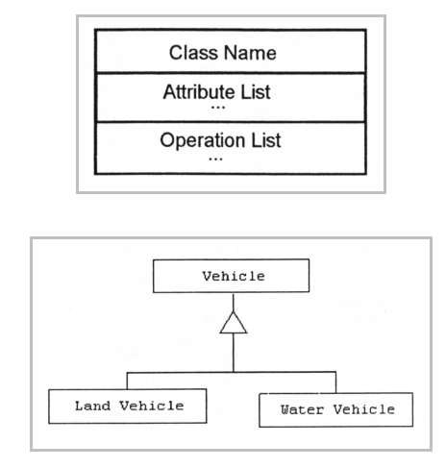
RUMBAUGH CLASS NOTATIONS

Slide 11
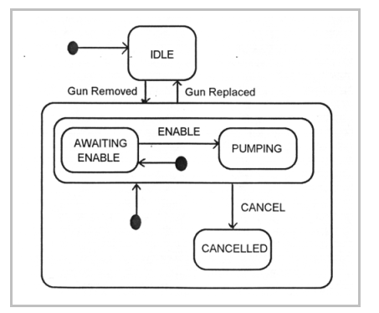
RUMBAUGH DYNAMIC MODEL

Slide 12
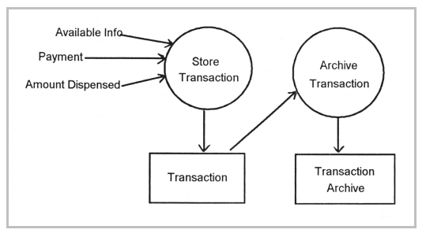
RUMBAUGH FUNCTIONAL MODEL

Slide 13
4.4 THE BOOCH METHODOLOGY
Widely used o-o methods to design systems using object paradigm.
Booch method consists of :
Class Diagrams
Object Diagrams
State Transition Diagrams
Module Diagrams
Process Diagrams
Interaction Diagrams

Slide 14
4.4 THE BOOCH METHODOLOGY contd..
Booch methodology consist of Macro and Micro development process
Macro development process: It serves as a controlling framework for micro process consists of:
- conceptualization
- analysis and development of the model
- design or create the system architecture
- evolution or implementation
- maintenance

Slide 15
4.4 THE BOOCH METHODOLOGY contd..
Each macro development process has its own micro development processes.
Micro process is a day-to-day activities
Micro development process consists of :
- identify classes and objects
- identify class and object semantics
- identify class and object relationships
- identify class and object interfaces and implementation

Slide 16
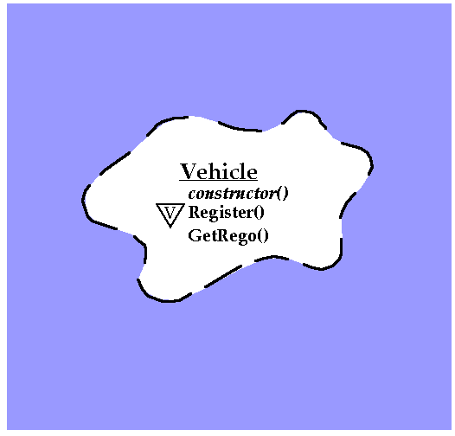
BOOCH NOTATIONS for CLASS

Slide 17
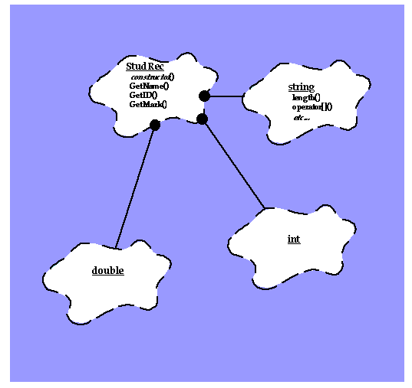
BOOCH NOTATIONS

Slide 18
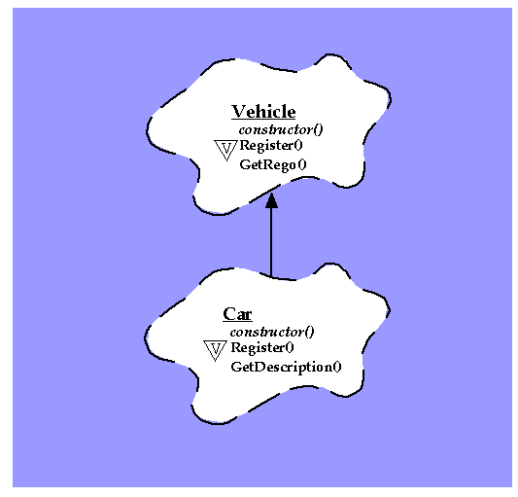
BOOCH NOTATIONS for CLASS INHERITANCE

Slide 19
4.5 THE JACOBSON ET AL. METHODOLOGY
This methodologies covers the entire life cycle and stress traceability between the different phases both forward & backward. It consists of:
OOBE (O-O Business Engineering)
OOSE (O-O Software Engineering) also called:
OBJECTORY (Object Factory for Software Development)

Slide 20
4.5 THE JACOBSON ET AL. METHODOLOGY contd..
Concept of use-case
- scenarios for understanding the system requirements
- is an interaction between user and system
- captures the goal of the user and responsibility of the system to its users

Slide 21
4.5 THE JACOBSON ET AL. METHODOLOGY contd..
The use case description must contain:
How and when the use case begins and ends.
The interaction between the use case and its actors, including when the interaction occurs and what is exchanged.
How and when the use case will need data stored in the system or will store data in the system.
Exceptions to the flow of events.
How and when concepts of the problem domain are handled.

Slide 22
4.5 THE JACOBSON ET AL. METHODOLOGY contd..
Every single use case should describe one main flow of events.
An exceptional or additional flow of events could be added.
The use case model employs extends and uses relationships.
Extend relationship extends the functionality of the original use case (like a subclass).
The Uses relationship reuses common behavior in different use cases.

Slide 23
4.5 THE JACOBSON ET AL. METHODOLOGY contd..
O-O Software Engineering: Objectory
OOSE also called objectory is a method of O-O development with the specific aim to fit the development of large, real time systems.
The development process is called use-case driven process. Used across:
Analysis, Design, Validation & Testing

Slide 24
4.5 THE JACOBSON ET AL. METHODOLOGY contd..
Objectory is built around several different models such as:
Use-case model
Domain Object model: The object of the real world are mapped into the domain object model.
Analysis Object model: It presents how the source code(implementation) should be carried out and written.
Implementation model:
Test model: It includes the test plans, specifications, and reports.

Slide 25
4.5 THE JACOBSON ET AL. METHODOLOGY contd..
O-O Business Engineering
OOBE is object modeling at the enterprise level. (Use case are also central here)
OOBE consists of :
Analysis phase
Design & Implementation phases
Testing phase: Unit, integration & system testing.

Slide 26
4.6 PATTERNS
A system can be analyzed, designed & built from Prefabricated & predefined system components – An Emerging Idea.
Sound documentation is the need in this case.
The use of design patterns originated by a building architect called Alexander in 1970s.
He motivated O-O researcher to describe commonly occurring design solutions and programming paradigms.

Slide 27
4.6 PATTERNS contd..
According to Gamma, Helm, Johnson & Vlissides design pattern :
“Identifies the key aspects of a common design structure that makes it useful for creating a reusable O-O design.”
“Further it identifies the participating classes and instances, their roles and collaborations, and the distribution of responsibilities.”

Slide 28
4.6 PATTERNS contd..
“Design Patterns describes when it applies, whether it can be applied in view of other design constraints and the consequences and trade-offs of its use.”
According to Riehle & Zullighoven:
“A pattern is [an] instructive information that captures the essential structure and insight of a successful family of proven solution to a recurring problem that arises within a certain context and system of forces.”

Slide 29
4.6 PATTERNS contd..
According to Coplien a good pattern will do the following:
It solves a problem.
It is a proven concept.
The solution is not obvious.
It describes a relationship. (i.e system structure & mechanism)
The pattern has a significant human component.

Slide 30
4.6 PATTERNS contd..
Patterns are used for :
Software architecture & design
Organization
Specification models
Software development process
Project planning
Requirements engineering
Software configuration management

Slide 31
4.6.1 GENERATIVE & NON GENERATIVE PATTERNS
Types of patterns are:
Generative Patterns: That only describe a recurring problem.
It tells how to generate something and can be observed in the resulting system architectures they help shape.
Nongenerative patterns are static and passive: They describe recurring phenomena without necessarily saying how to reproduce them.
Most of the patterns are generative.

Slide 32
4.6.2 PATTERNS TEMPLATE
Patterns Template:
Name: A meaningful pattern name.
Problem: A statement of the problem.
Context: The precondition under which the problem and its solution seem to recur and for which solution is desirable.
Forces: Relevant forces & constraints under which the system has to work.

Slide 33
4.6 PATTERNS TEMPLATE contd..
Solutions: Static relationships & dynamic rules describing how to realize the desired outcome.
Examples: Sample application of pattern.
Resulting context: The state of or configuration of the system after the pattern has been applied. (It describes the postconditions & side effects of the patterns, which is called resolution of forces.)

Slide 34
4.6 PATTERNS TEMPLATE contd..
Rationale: A justifying explanation of steps or rules in the pattern.
Related patterns: The static & dynamic relationship between this pattern and others.
Known uses: The known occurrences of the patterns and its application within existing system.

Slide 35
How Patterns Arise-A Summary
Problem
Context
Forces
Solution
Benefits
Consequences
Related Patterns

Slide 36

Pattern Examples: Facade
Provide unified interface to interfaces within a subsystem
Shield clients from subsystem components
Promote weak coupling between client and subsystem components
Client
Facade
The facade at Bletchley Park, UK is a mix of architectural styles.

Slide 37
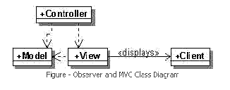
Some more Examples of Patterns
Observer and MVC
An application with Model - View - Controller setup usually uses the Observer Pattern.
In a Java webserver environment the Model will be represented by Java classes encompassing the business logic,
The View is represented by Java Server Pages which display HTML in the client's browser &
We will have a Servlets as Controllers.

Slide 38
RESOURCES: Java Design Patterns - Tutorials
http://books.google.co.in/books?id=SrJRu8T69FcC&dq=design+patterns&printsec=frontcover&source=bl&ots=_pkpT0cXob&sig=FPhwLXWY3DQUN9Fah-_Z9wvG7Xs&hl=en&ei=JTCMSvGgOtCIkQW379wj&sa=X&oi=book_result&ct=result&resnum=10#v=onepage&q=&f=false

Slide 39
4.6.3 ANTIPATTERNS
A pattern represents a “best practice”.
Antipattern represents “worst practice” or a “lesson learned”. Two varieties of it are:
Those describing a bad solution to a problem that resulted in a bad situation.
Those describing how to get out of bad situation and how to proceed from there to a good solution.
It is an important research activity.

Slide 40
4.6.4 CAPTURING PATTERNS
Writing good pattern is very difficult.
The process of looking for patterns to document is called pattern mining or reverse architecting.
It is important to note that a solution in which no forces are present is not a pattern.

Slide 41
4.6.4 CAPTURING PATTERNS contd..
Buschmann et al guidelines for capturing patterns are:
Focus on practicability: Pattern should describe proven solutions.
Aggressive disregard of originality : Pattern writer need not be the original inventor.
Nonanonymous review : To improve upon.
Writers’ workshop instead of presentation:
Careful editing :

Slide 42
END

